Slide 1

Vue 3 Developer Experience

Slide 2
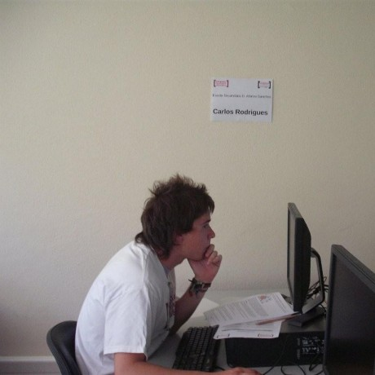


Carlos Rodrigues
Consultant and Vue Core team Member
@pikax
@pikax_dev

Slide 3
What is DX
DX (Developer Experience) is equivalent to UX (User Experience) but for developers. It’s composed by 4 key principles:
Clarity: How intuitive the tool is.
Ease of Use: How easy is to use.
Stability: How stable is the tool.
Function: What functionality the tool provides.
Least important
Clarity
Ease of Use
Stability
Function
More important

Slide 4
Vue 3 DX Improvements

Slide 5
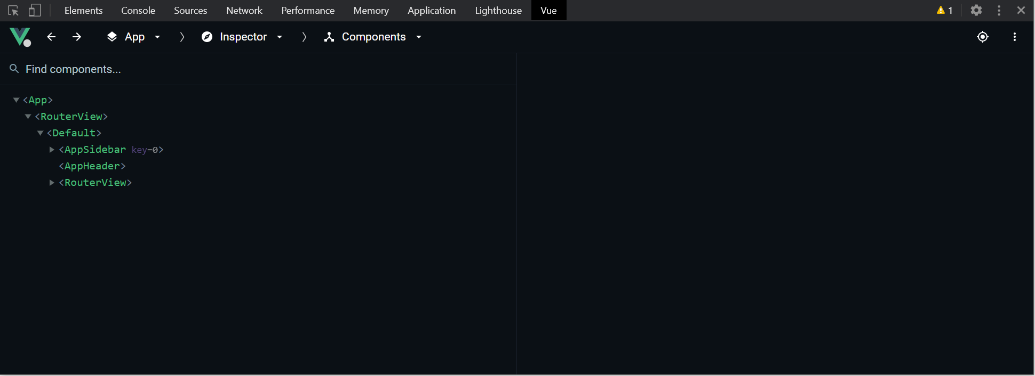
New Vue.js devtools beta
Major refactor for vue3 support
Multi-app support
Custom inspectors
Timeline

Slide 6
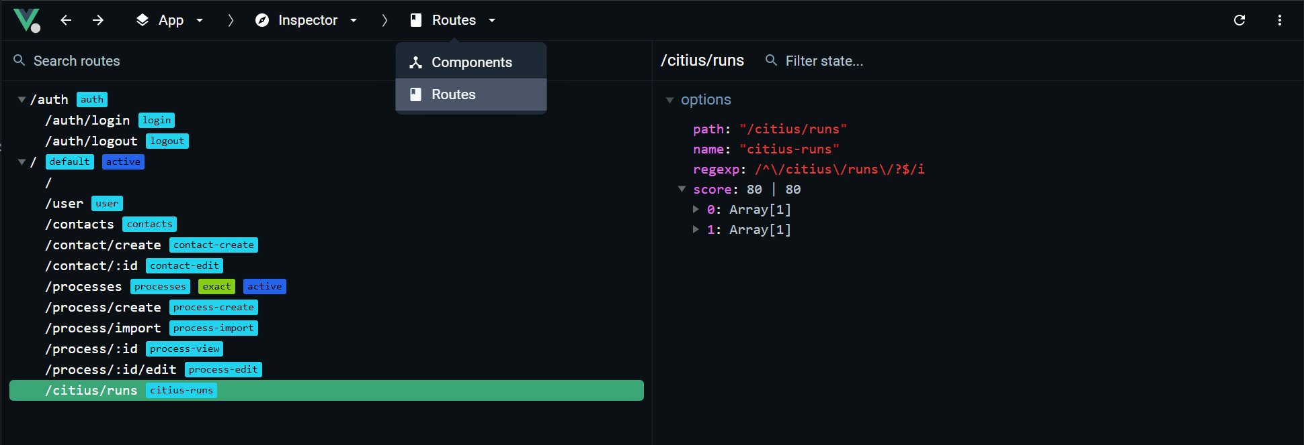
Custom inspectors

Slide 7
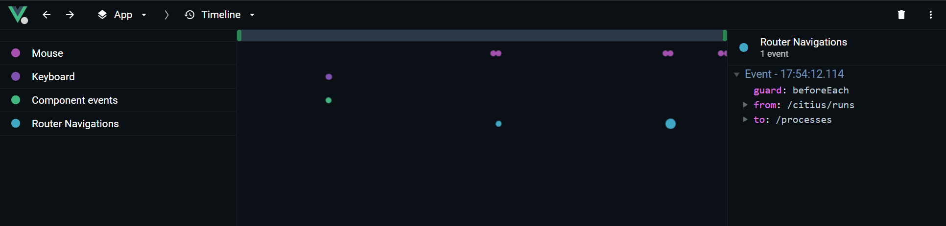
Timeline

Slide 8
Devtools extensibility
You can extend devtools by:
Bespoke inspectors
Timeline events

Slide 9
Vite
Vite is an opinionated web dev build tool that serves your code via native ES Module imports during dev and bundles it with Rollup for production.
Lightning-fast cold server start
Instant hot module replacement (HMR)
True on-demand compilation

Slide 10

Vite... how fast?

Slide 11


Slide 12
Create and run in 40 seconds

Slide 13
Not impressed with create-app example?

Slide 14
Time to run vue-router-next docs

Slide 15
Typescript
Vue3 is built with Typescript, this brings a greater information to the IDE.
This will improve the auto-completion on VSCode, Webstorm, etc.
It also enhances Javascript.

Slide 16
Composition-API
For more complex application, composition-api improves the DX quite a lot, enabling
Better code separation
Code composition
Better Typescript support

Slide 17
Single File Component
The recommended way to write vue components is by using SFC (Single File Component) which is composed by different sections:
Template: HTML based syntax, pug, etc.
Script: Javascript, Typescript, etc
Style: CSS, SASS, SCSS, Stylus, etc
Bespoke: eg: <i18n/>

Slide 18
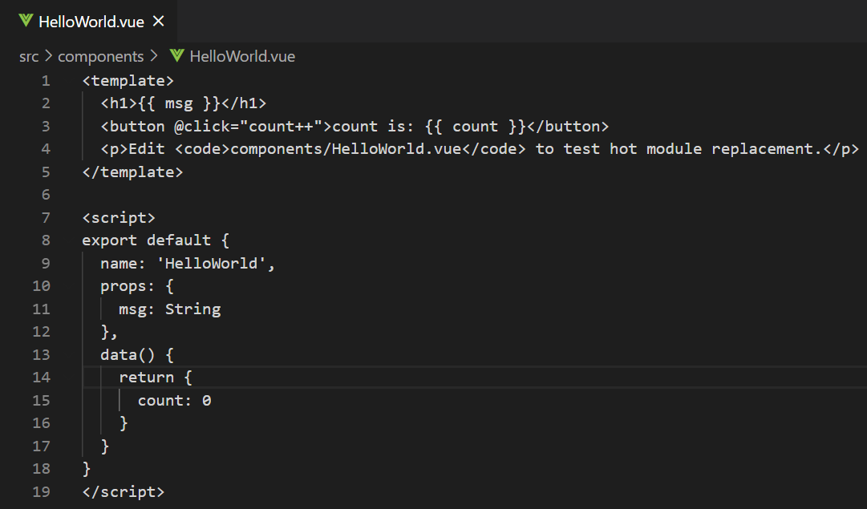
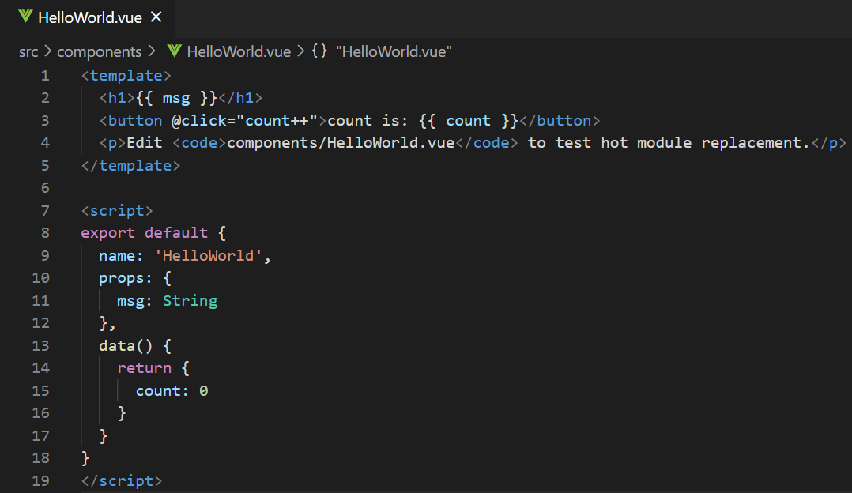
DX on SFC
To achieve a good DX on SFC components, editor support is required.

Slide 19
Improvements on Vue 3
Vetur
Vue Developer Experience

Slide 20
Vetur

Slide 21
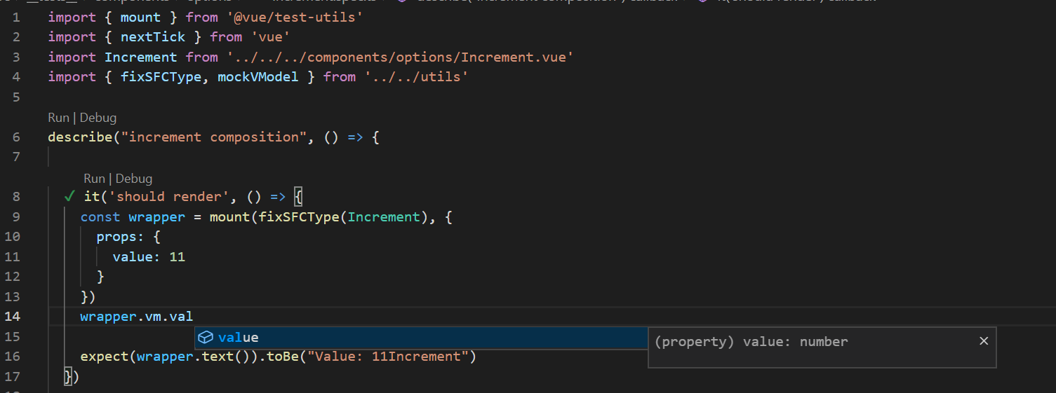
Typesafe testing
VueDX open some interesting possibilities since it allows typescript to understand .vue files

Slide 22
Repo
You can check the repo: https://github.com/pikax/vue-dx-porto

Slide 23
Brighter 2021
Libraries will catch up with vue 3
More libraries and tools will be created to take advantage of the new features
Better Typescript support
Better/improved tooling

Slide 24
Questions?

